Slide 1
NGSS Interim Assessments
Todd Campbell, Professor – Science Education, University of Connecticut
John Duffy, PreK-12 Science Curriculum Coordinator – Southington Public Schools
Jeff Greig, Science Assessment – Connecticut State Department of Education

Slide 2
Session Outline
How the assessments should support the vision and key shifts of NGSS and CT’s proposed NGSS assessment system
3-D Interim Assessments Guided by Coherence, Shared Models of Learning, and Attention to Equity STEM Teaching Tool Micro-Dive
Our Key Takeaways Important in our Learning about Interim Assessment
Statewide Initiatives to Support Interim Assessment
Example of Interim Assessments Embedded in Secondary (Grade 7) Curriculum

Slide 3


NGSS Assessments:
Supporting the Vision and Key Shifts
Less memorizing of factual knowledge and more sense making
Use of real-world phenomena that engage students in problem solving
3-Dimensional science learning that integrates the SEPs, DCIs and CCCs
Equitable opportunities for all students

Slide 4
Proposed System of NGSS Assessments
The goal is to provide useful information for a variety of purposes and audiences.
Formative Assessment Resources*: Process used every day by teachers to monitor student learning in the classroom and help make ongoing instructional adjustments to better meet student needs. VOLUNTARY
Local Assessment Resources*: Assessment resources, including PD supports, used to support ongoing instruction. Developed from a variety of sources including local CT school districts. VOLUNTARY
Greater frequency of use
More useful to students and teachers
Interim Assessments*: Assessments administered at the end of units or grades to evaluate the learning of groups of students to inform curriculum and instruction at the local level. VOLUNTARY
State Summative Assessments: Assessments given at the end of learning (Grades 5, 8 and 11) to track student performance and inform decisions about curriculum, instruction, professional development, and policy for a variety of stakeholders. MANDATED BY FEDERAL AND STATE LAW
* Formative and local/interim assessment resources will come from a variety of sources and be shared by districts and states around the country.

Slide 5

3-D Interim Assessments Guided by Coherence, Shared Models of Learning, and Attention to Equity STEM Teaching Tool Micro-Dive
Considering the following questions, take 5-7 mins to read the STT:
  What might be most important to think about related to interim assessments?
  What ideas or resources might support your work? How?
  Small group discussion/Large group share out

Slide 6
Our Key Takeaways Important in our Learning about Interim Assessment
To date, little emphasis has been placed on interim assessments (IAs).
IAs can provide needed information that can be examined with other teachers and leaders within the same district to support targeted approaches for improving future instruction.
IAs are common classroom assessments administered by groups of teachers . . . can be used to elicit insight into students’ facility with 3Ds in explaining phenomena or solving problems. Can provide information to individual teachers . . . can [also] be meaningfully aggregated to provide information at broader levels.

Slide 7
Our Key Takeaways Important in our Learning about Interim Assessment Cont.
NOT as practice for assessments, [instead] as a bridge to help students connect what they are learning daily with opportunities they’ll have to engage in and demonstrate learning on summative assessments
Issues to Consider: What coherent shared model of learning guides curriculum, instruction, and interim assessments
Equity: Assessments should focus on relevant phenomena or problems to elicit explanations or solutions that are relatable to the intended audience and draw on student and community interests and expertise

Slide 8
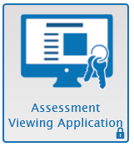
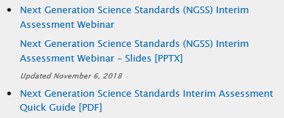
NGSS Interim Assessments
Released on October 15
Same item clusters as in 2019
(will be administered individually instead of in pairs)
Grade | No. of Item Clusters
3-5 | 14
6-8 | 20
High School | 20
Educators can access NGSS interims in the Assessment Viewing Application
through the web portal: https://ct.portal.airast.org
Resources available:
Using NGSS Interim Assessments in the Classroom:
https://www.youtube.com/watch?v=nrp9bSf2L7E&t=8s

Slide 9
Considerations Prior to Using
NGSS Interim Assessments
Where do the NGSS interim assessments fit into my curriculum?
In which ways do the interims complement and support individualized and group instruction?
How will the results of the NGSS interim assessments be used?
What purpose(s) will the NGSS interim assessments serve in my classroom, school or district?

Slide 10
Using the NGSS Interims to
Inform Teacher Learning
NGSS Interim Assessments allow teachers to see what three-dimensional science assessment looks like and how it is different from traditional assessments.
Ask teachers to respond to the items and think about what students need to be able to do to be successful.

Slide 11
Some Questions for Teachers to Consider
Have teachers complete an NGSS interim item and then discuss the following questions:
What is this item measuring?
How challenging is the item (easy, moderate, or difficult)?
What science practices do students use to answer the questions?
What key concepts do students need to apply in answering the questions?
How might the language used, information presented and/or manipulation skills present challenges for my students?

Slide 12
Using the NGSS Interims to
Inform Student Learning
NGSS Interim Assessments allow teachers to check student progress throughout the year, gaining access to information that can be used to improve instruction and help students meet the challenges of “three-dimensional” standards.

Slide 13
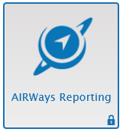
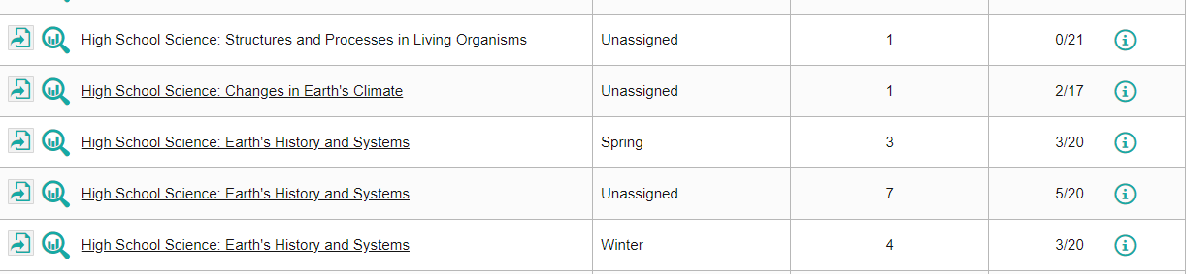
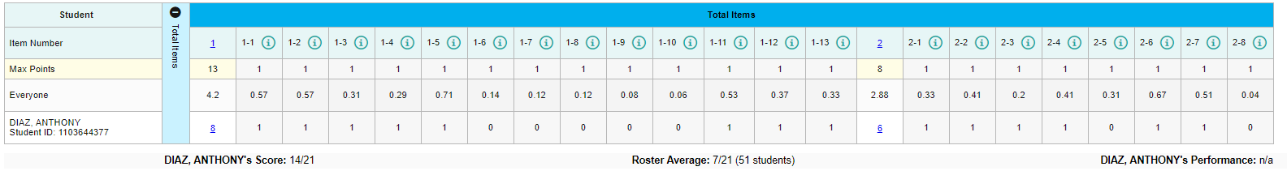
NGSS Interim Assessment Results
First Stop in AIRWays – the Dashboard
Breakdown of student performance by scoring assertion
Sample Student
Scoring assertions indicate specific student performances included in an interim assessment item.

Slide 14
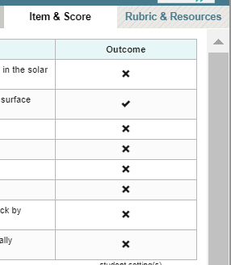
NGSS Interim Assessment Results
Results can be reviewed for each scoring assertion for groups of students or by individual student.

Slide 15

Looking at the Results
  Were there items/assertions on which most students struggled or did well on?
  Were there trends in student responses based on particular types of items/questions?
  Based on their performance, what types of instruction would benefit students?

Slide 16

Local Assessment Resources in Science (LARS)
Goal: To help school districts in CT share locally-developed NGSS assessment resources.
Two Types of Resources:
Student assessments (Grades K-12)
Teacher professional learning
Anyone will be able to submit resources to be considered for sharing.
Submitted resources will go through a review process to ensure they are of high quality.

Slide 17

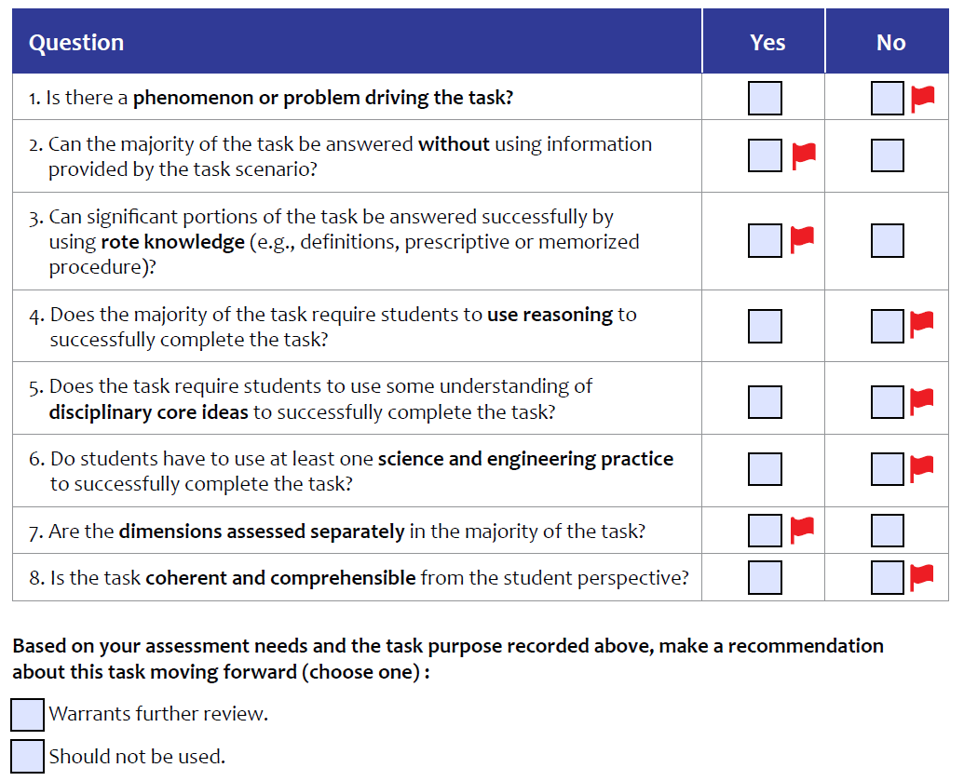

LARS: Student Assessment Review Process
In-Depth Assessment Task Review
Phenomena and/or Problem
Alignment to 3D Performance Expectation(s)
Scientific Accuracy
Fair and Equitable to All Students
Scoring Guidance and Teacher Supports
Feedback will be provided to the submitter.
Initial Submission of Resource
Pilot Testing
Scoring and Collection of Student Work
Release to Public Web Site
We hope to make some resources available this winter.
https://www.nextgenscience.org/sites/default/files/resource/files/Achieve%20Task%20PreScreener_Final_9.21.18.pdf
LARS Contact: Jeff Greig (jeff.greig@ct.gov)

Slide 18
Final Thought
In drawing any conclusions or making any decisions about student learning, always use multiple sources of evidence, including results from formative, local/interim, and summative assessments.
Summative
Assessments
Local/Interim
Assessments
Profiles of Student Learning
Formative
Assessments

Slide 19
Southington’s Assessment Journey
Grade 7, Life Science Unit example
Disruptions In Ecosystems
American Museum of Natural History
The Lawrence Hall of Science
NSF Funded
Achieve endorsed for assessments

Slide 20
First Step – Claim, Evidence, Reasoning (CER)
Bye Bye Birdie part 1 from Data Nuggets (http://datanuggets.org/)
  Data Nuggets are free classroom activities, co-designed by scientists and teachers, designed to bring contemporary research and authentic data into the classroom. Data Nuggets include a connection to the scientist behind the data and the true story of their research. Each activity gives students practice working with “messy data” and interpreting quantitative information. Scoring rubric is provided to teachers.
Student work was analyzed in grade level team and teachers zeroed in on student struggles to identify evidence and connect evidence to their claim (falling into the 3-5 grade band on the Engaging in argument from evidence progressions) but teachers found it difficult to hone in on student weaknesses.
Notes:
Provided scoring rubric proved difficult to use in identifying specific weaknesses in SEPs or CCCs

Slide 21
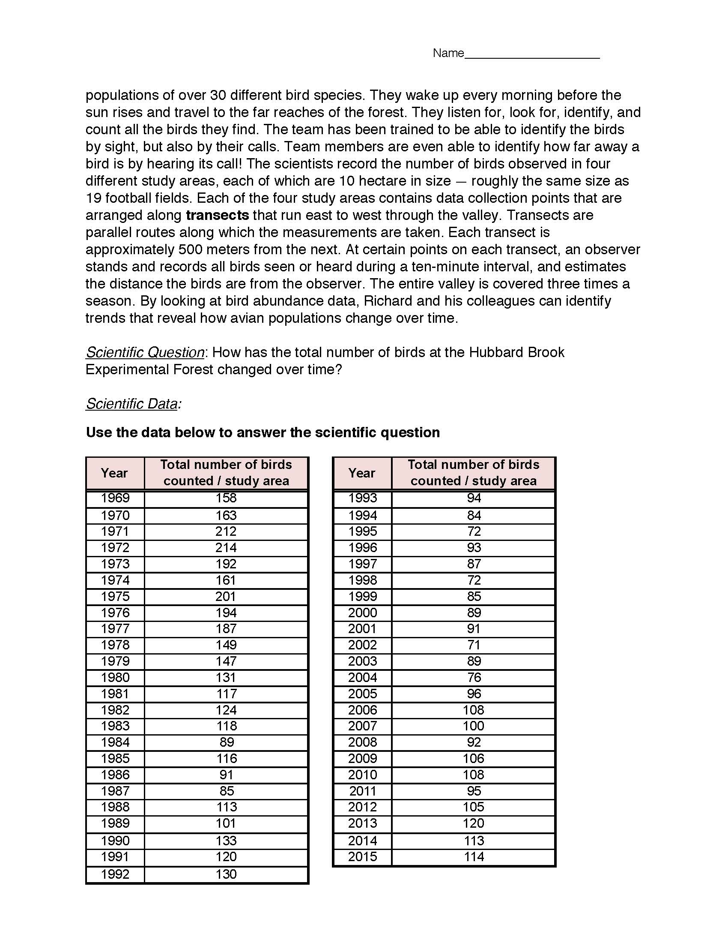
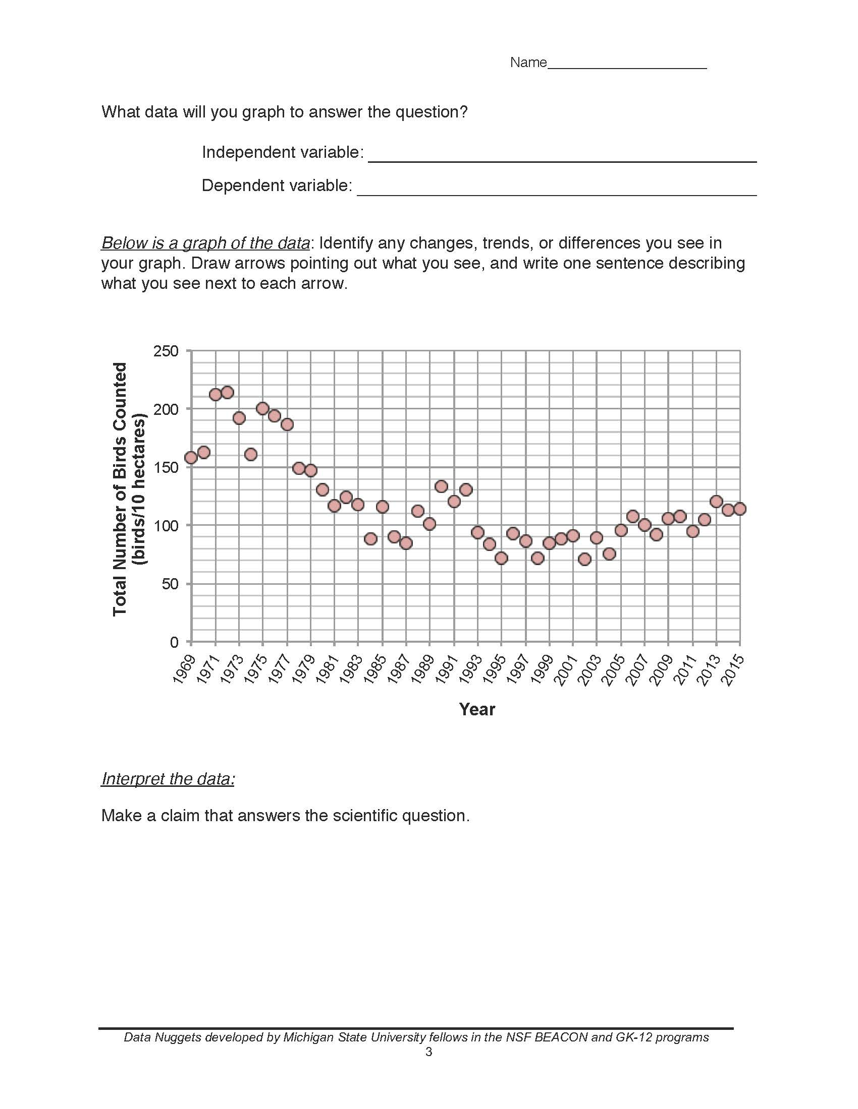

Slide 22
Original Bye Bye Birdie Assessment
Given a scientific question, data table and graph students were asked:
Identify any changes, trends, or differences you see in your graph. Draw arrows pointing out what you see, and write one sentence describing what you see next to each arrow.
Interpret the data: Make a claim that answers the scientific question
What evidence was used to write your claim? Reference specific parts of the tables or graph.
Explain your reasoning and why the evidence supports your claim.

Slide 23
Revised Assessment
Identify one change and one trend you see in the graph. Draw arrows pointing out what you see, and write one sentence describing what you see next to each arrow.
Make a claim that answers the scientific question.
Describe how evidence from the table supports your claim.
Describe how evidence from the graph supports your claim.
Use the table and/or graph to predict how many birds will be counted in the year you graduate from high school, 2025. Explain how you used the data to make your prediction.

Slide 24
CER Scaffolding in Disruptions Unit
Question: Record the question “What effect does a large population of deer have on an ecosystem?”
Evidence: Examine information and data from the reading.
Science Concepts: List any science concepts that are connected to the evidence and might help answer the question.
Scientific Reasoning: Describe the scientific reasoning that connects the evidence and science concepts to the question you are trying to answer.
Claim: Based on the evidence of patterns in the data and on your scientific reasoning, state your claim about the effect of a large population of deer on an ecosystem

Slide 25
CER Rubric Developed for Grades 6-8
The rubric to evaluate CERs provided consistency but limited SEP and CCC information
Our emphasis the past two years has been on NGSS instruction with the CERs our primary assessment tool
This year teachers have recognized the need to zero in on specific SEPs and CCCs
And the need for 3-D assessments to measure student progress in SEPs and CCCs

Slide 26
Ongoing Assessment Work
We began this year with discussions about what are we really measuring and where are our students struggling (SEPs and CCCs)
We used appendices F (SEPs) and G (CCCs) to focus our assessments on Practices and cross cutting concepts.
We revised the Bye Bye Birdie assessment and rubric to measure student abilities to analyze and interpret data, and identify patterns
Teachers began identifying other assessments (CT Interims, SNAP, NextGenAssessment/Concord) that best fit our curriculum units

Slide 27
Ongoing Assessment Work – Use of CT Interims
Grade 6 – Thermal Energy
MS Matter and Its Interactions Item 1 (Tea Kettle) - Using Models, Cause and Effect
Grade 7 – Growth in Living Things
MS Matter and Its Interactions Item 2 (Chemical Reaction) – Analyzing Data, Systems
Grade 8 – Forces and Motion
MS Forces, Interactions and Energy Item 1 (block and string) – Analyzing data plan investigations

Slide 28
Ongoing Assessment Work
We recognize the importance of reviewing student work (big lift – time consuming)
We recognize the importance of the assessments “fitting” our curriculum – measuring practices and cross-cutting concepts consistent with our curriculum
We will administer an interim assessment, all students in a grade level within a window of time, during each unit of study, by the midpoint of the unit – to allow time for the results to inform our instruction
We’re using some readily available, some modified and some of our own via Canvas.
Teachers are beginning to understand that our alignment is with the intent of the Framework, not the PEs of the NGSS

Slide 29
Alignment to the Framework
Goals for student learning:
Understand, use, develop, and interpret scientific explanations of the natural world
Generate and evaluate scientific evidence and explanations
Understand the nature and development of scientific knowledge
Participate productively in scientific practices and discourse
All connected to the Science concepts of the DCIs

Slide 30
Thank You
Contact Information
Todd Campbell (todd.Campbell@uconn.edu)
John Duffy (jduffy@southingtonschools.org)
Jeff Greig (Jeff.Greig@ct.gov)

