Slide 1
COVID-19 and Systemic Racism:
Creating “A New Normal” for STEM Education
with Social Justice for All Students
Okhee Lee, New York University
Todd Campbell, University of Connecticut
November 16, 2020
olee@nyu.edu @OkheeLee_ OkheeLee.com
todd.campbell@uconn.edu @dtcampbe

Slide 2
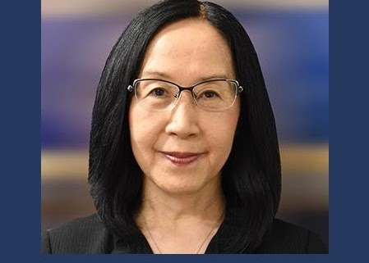
Okhee Lee
Research focuses on equity in science and STEM education for all students, especially English learners
Policy contributions include serving on the NGSS writing team and leading the NGSS Diversity and Equity Team
Practice commitment was recognized by the 2020 NSTA Distinguished Service to Science Education award
Email olee@nyu.edu
Twitter @OkheeLee_
Website okheelee.com

Slide 3
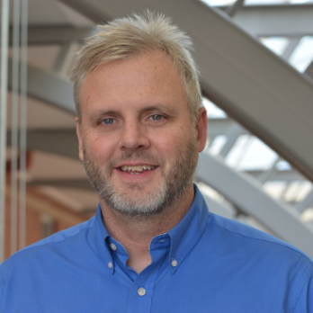
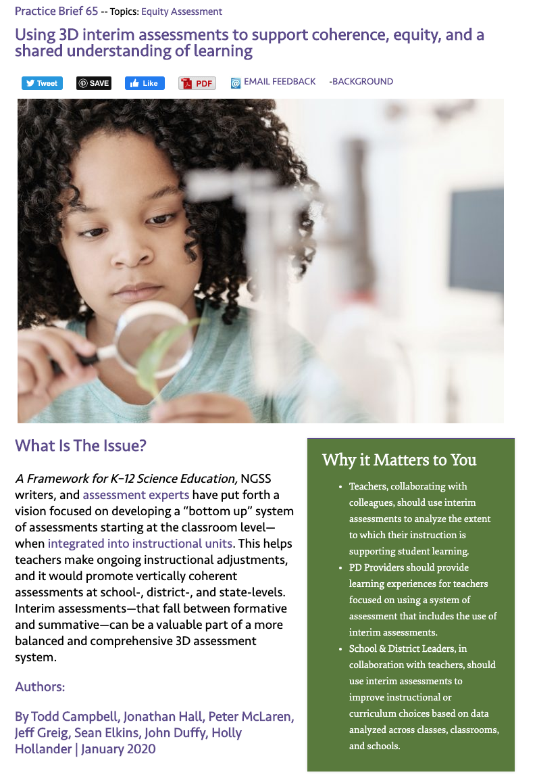
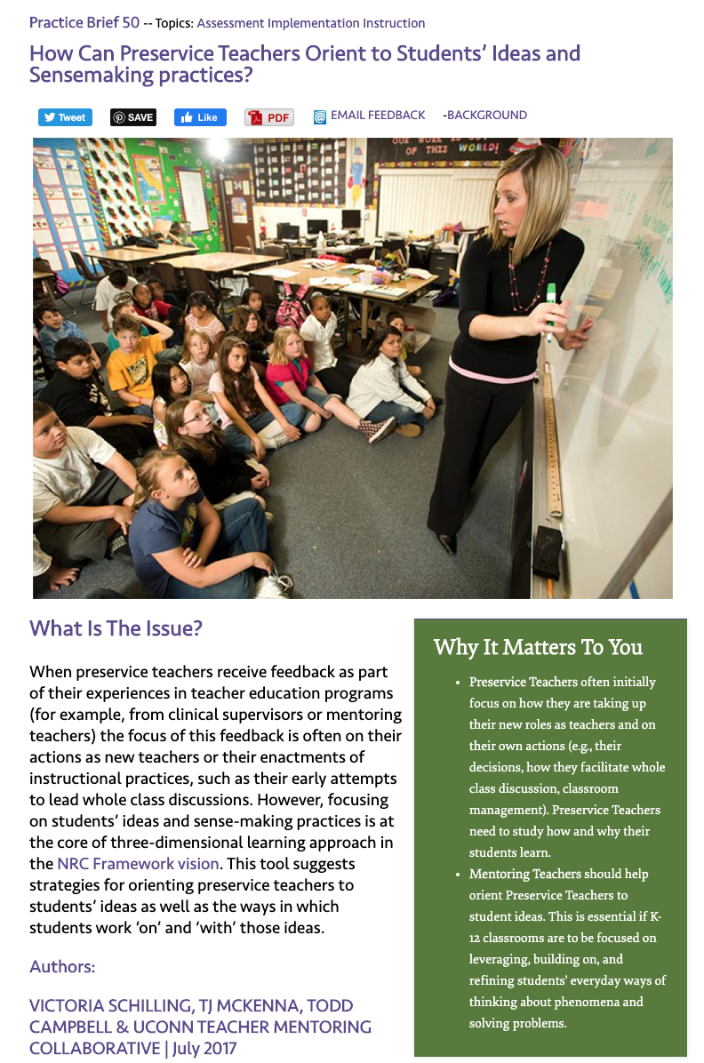
Todd Campbell
Research focuses on cultivating imaginative and equitable representations of STEM
Policy contributions include scholarly publications focused on the implementation of national and state standards
Practice commitment is embodied in the publication of several practice briefs and practitioner-oriented articles
Email todd.campbell@uconn.edu
Twitter @dtcampbe

Slide 4
Purpose
The purpose is to propose an instructional framework for STEM education that is centered around social justice for all students
The instructional framework leverages data science, computer science, and convergence of STEM disciplines, which are key to finding solutions to COVID-19 while being complicit with systemic racism
The instructional framework involves STEM disciplines and STEM education working in concert to address systemic racism
Notes:
Okhee

Slide 5
Proposed Instructional Framework
Area 1. Using data science and computer science, students make sense of complex real-world phenomena and problems
Area 2. Through the convergence of multiple STEM subjects, students make informed decisions and take responsible actions
Area 3. STEM education should promote social justice for all students
Disclaimer: The three colors do not correspond to NGSS three dimensions, but this presentation illustrates how to develop NGSS storylines.
Lee, O., & Campbell, D. T. (2020). What science and STEM teachers can learn from COVID-19: Harnessing data science and computer science through the convergence of multiple STEM subjects. Journal of Science Teacher Education, 31(8), 932-944.
Notes:
Okhee

Slide 6
Area 1: Data Science and Computer Science
Area 1: Data science and computer science promote K-12 students to make sense of phenomena and complex societal problems
Students find phenomena compelling to figure out
Johns Hopkins University
Coronavirus Resource Center
https://coronavirus.jhu.edu/map.html
Notes:
Okhee

Slide 7
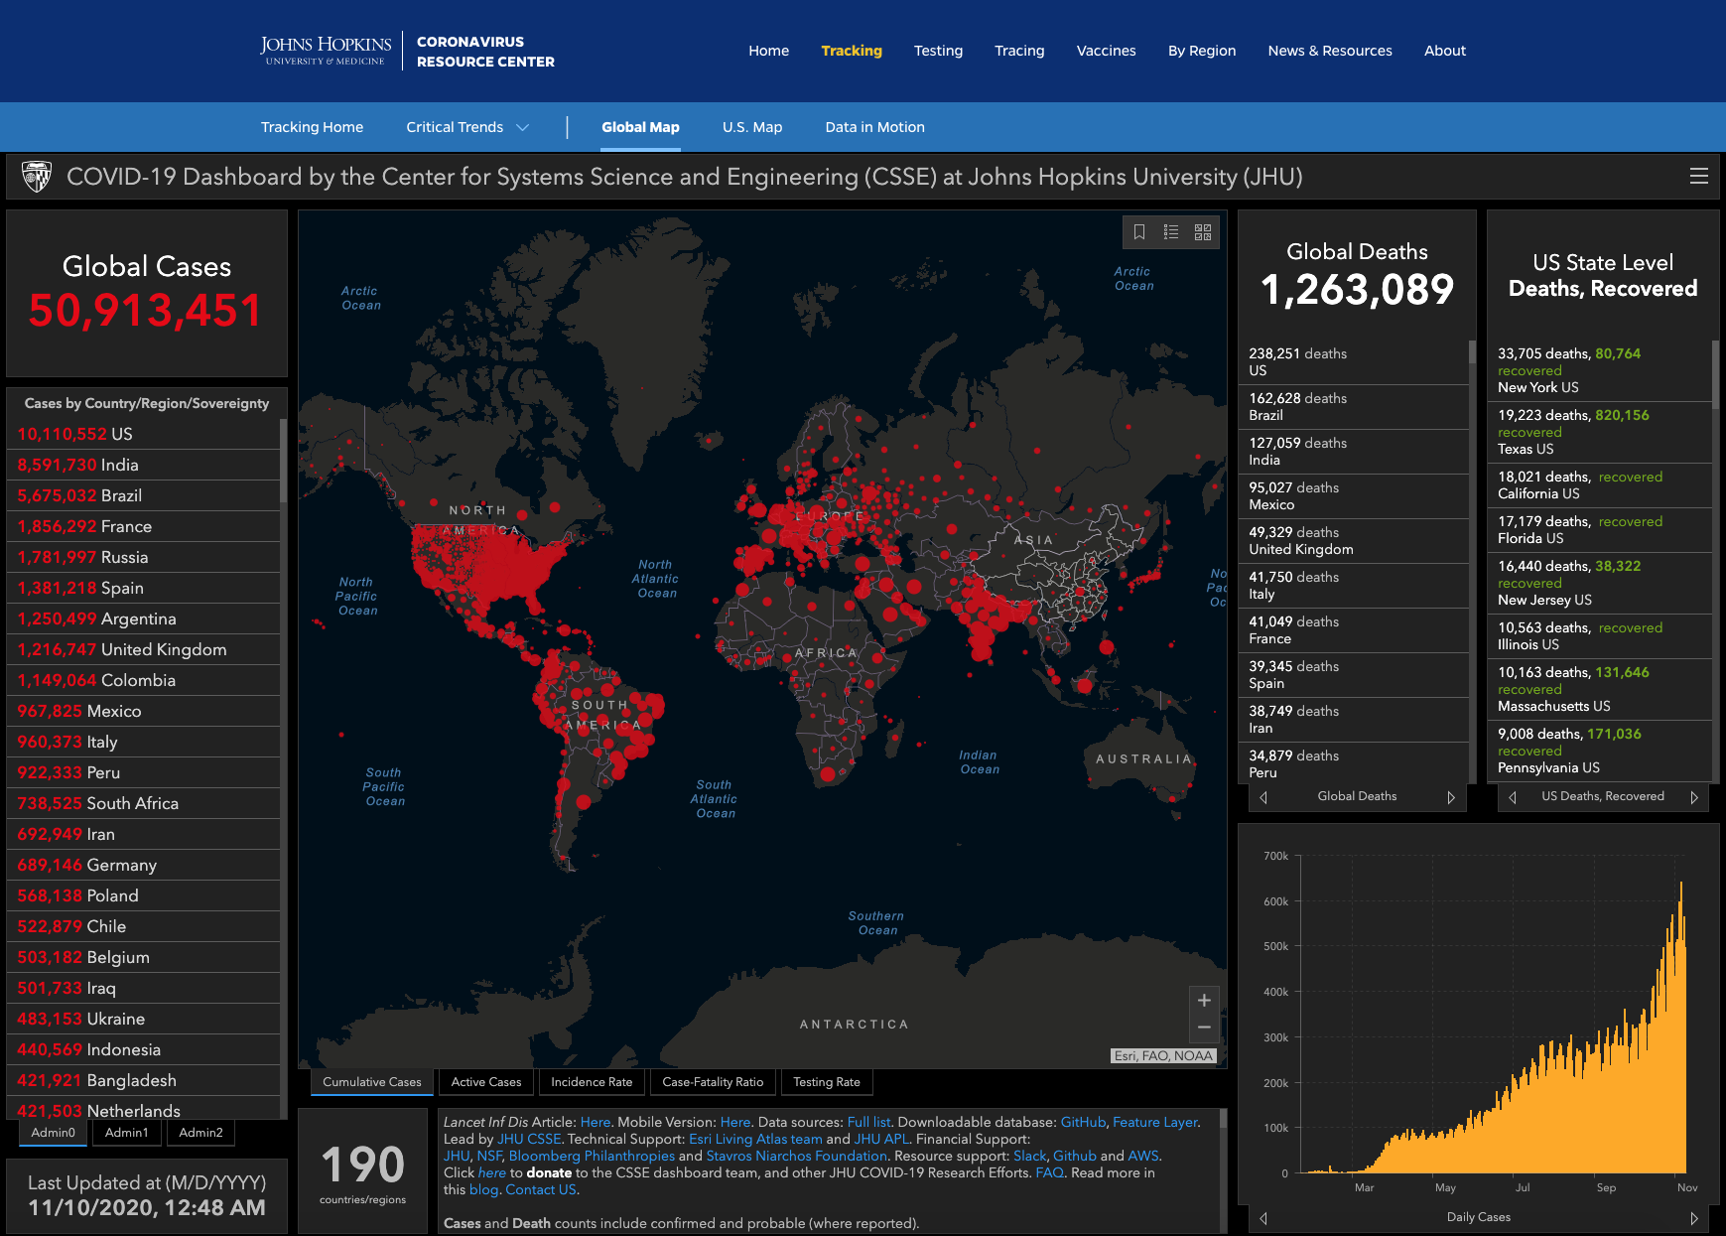
Johns Hopkins Coronavirus Resource Center Johns Hopkins University & Medicine https://coronavirus.jhu.edu https://coronavirus.jhu.edu/map.html
Area 1: Data Science and Computer Science
Notes:
Okhee

Slide 8
Area 1: Data Science and Computer Science
Johns Hopkins University Coronavirus Resource Center
https://coronavirus.jhu.edu/map.html
In breakout rooms, answer the following questions (7 min):
As of 7:15 pm EST on November 16, 2020:
1) Worldwide, the data show X confirmed cases and X deaths
In the US, the data show X confirmed cases and X deaths
In NY, the data show X confirmed cases and X deaths
2) The X confirmed cases in the US constitute X% worldwide
The X deaths in the United States constitute X% worldwide
3) Explore your own district
a) Go to “US Map”
b) Type “States/Territories”
c) Type “County (or Equivalent)”
Notes:
Okhee

Slide 9
Area 1: Data Science and Computer Science
A Sample of Data Sources
University Research Centers
Johns Hopkins University: Coronavirus Resource Center
https://coronavirus.jhu.edu/map.html
Our World in Data: Statistics and Research Coronavirus Pandemic (COVID-19)
https://ourworldindata.org/coronavirus
News Media
Bloomberg: Mapping the Coronavirus Outbreak Across the World
https://www.bloomberg.com/graphics/2020-coronavirus-cases-world-map/?utm_source=twitter&utm_medium=cpc&utm_campaign=covid_tracker&utm_content=tofu
Financial Times: Coronavirus Tracked: The Latest Figures as Countries Start to Reopen
https://www.ft.com/content/a26fbf7e-48f8-11ea-aeb3-955839e06441?campaign=march20&segmentID=91adc6f0-8387-0702-925f-7e46769f36ab
The New York Times: Coronavirus Map: Tracking the Global Outbreak
https://www.nytimes.com/interactive/2020/world/coronavirus-maps.html?campaign_id=9&emc=edit_NN_p_20200424&instance_id=17910&nl=morning-briefing&regi_id=128196943&section=topNews&segment_id=25875&te=1&user_id=8a1534b4d44c04ec54f11d47daf73a58
The Washington Post: Guide to the Pandemic
Notes:
Okhee

Slide 10
Area 1: Data Science and Computer Science
Area 1: Data science and computer science promote K-12 students to make sense of phenomena and complex societal problems
2) Students explain phenomena and design solutions to problems
The Washington Post
“Why Outbreaks Like Coronavirus Spread Exponentially, and How to ‘Flatten the Curve’”
https://www.washingtonpost.com/graphics/2020/world/corona-simulator/
Notes:
Todd

Slide 11
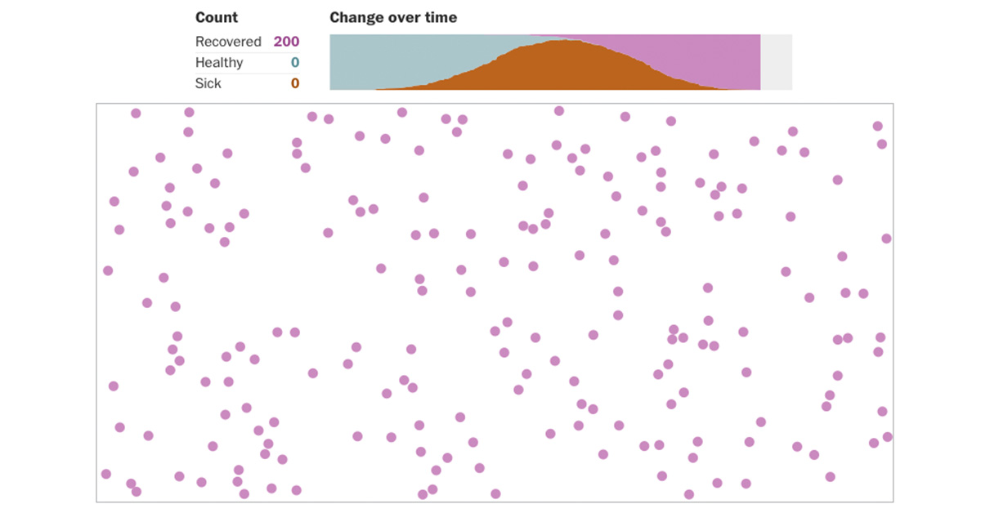
Area 1: Data Science and Computer Science
Example of Publicly Available Computer Simulations Using COVID-19 Data
The Washington Post
“Why Outbreaks Like Coronavirus Spread Exponentially, and How to ‘Flatten the Curve’”
https://www.washingtonpost.com/graphics/2020/world/corona-simulator/
Notes:
Todd

Slide 12
Area 1: Data Science and Computer Science
Area 1: Data science and computer science promote K-12 students to make sense of phenomena and complex societal problems
In breakout rooms, try out the following computer simulation model (7 min)
The Washington Post
“Why Outbreaks Like Coronavirus Spread Exponentially, and How to ‘Flatten the Curve’”
https://www.washingtonpost.com/graphics/2020/world/corona-simulator/
Notes:
Todd

Slide 13
Area 1: Data Science and Computer Science
Area 1: Data science and computer science promote K-12 students to make sense of phenomena and complex societal problems
The Washington Post
“Why Outbreaks Like Coronavirus Spread Exponentially, and How to ‘Flatten the Curve’”
https://www.washingtonpost.com/graphics/2020/world/corona-simulator/
“Disease Modelers Are Wary of Reopening the Country. Here’s How They Arrive at Their Verdict. To See How Their Models Work, We’ll Let You Tweak Your Own” https://www.washingtonpost.com/graphics/2020/health/disease-modeling-coronavirus-cases-reopening/?utm_campaign=wp_post_most&utm_medium=email&utm_source=newsletter&wpisrc=nl_most
Notes:
Todd

Slide 14
Area 2: Convergence of Multiple STEM Subjects
Area 2: Convergence of multiple STEM subjects facilitate K-12 students making informed decisions and taking responsible actions
1) Solutions to the COVID-19 pandemic involve each individual doing their part
Reuters
“The Korean Clusters,” by M. Hernandez, S. Scarr, and M. Sharma, 2020
https://graphics.reuters.com/CHINA-HEALTH-SOUTHKOREA-CLUSTERS/0100B5G33SB/index.html
Social distancing
Contact tracing
Notes:
Okhee

Slide 15
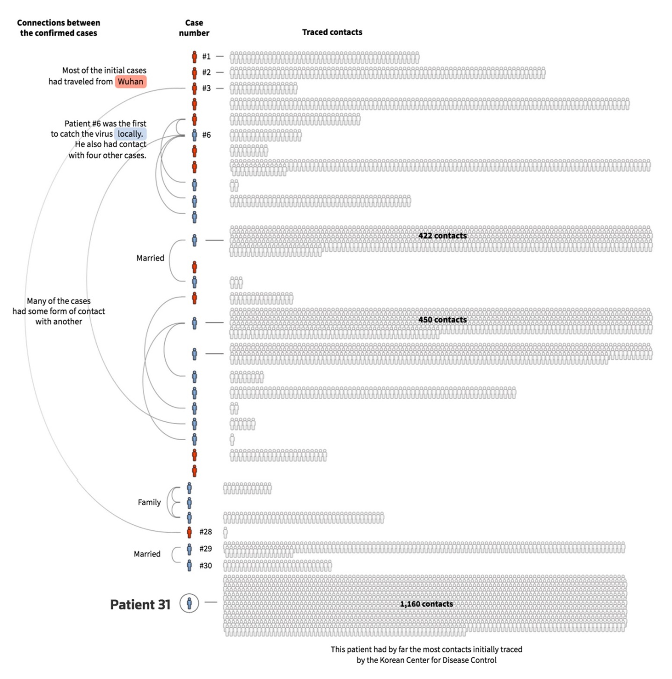
Area 2: Convergence of Multiple STEM Subjects
How COVID-19 spread through Daegu, South Korea
Reuters
“The Korean Clusters,” by M. Hernandez, S. Scarr, & M. Sharma, 2020
https://graphics.reuters.com/CHINA-HEALTH-SOUTHKOREA-CLUSTERS/0100B5G33SB/index.html

Slide 16
Area 2: Convergence of Multiple STEM Subjects
Area 2: Convergence of multiple STEM subjects facilitate K-12 students making informed decisions and taking responsible actions
2) Solutions to the COVID-19 pandemic involve each society doing its part
Notes:
Okhee

Slide 17
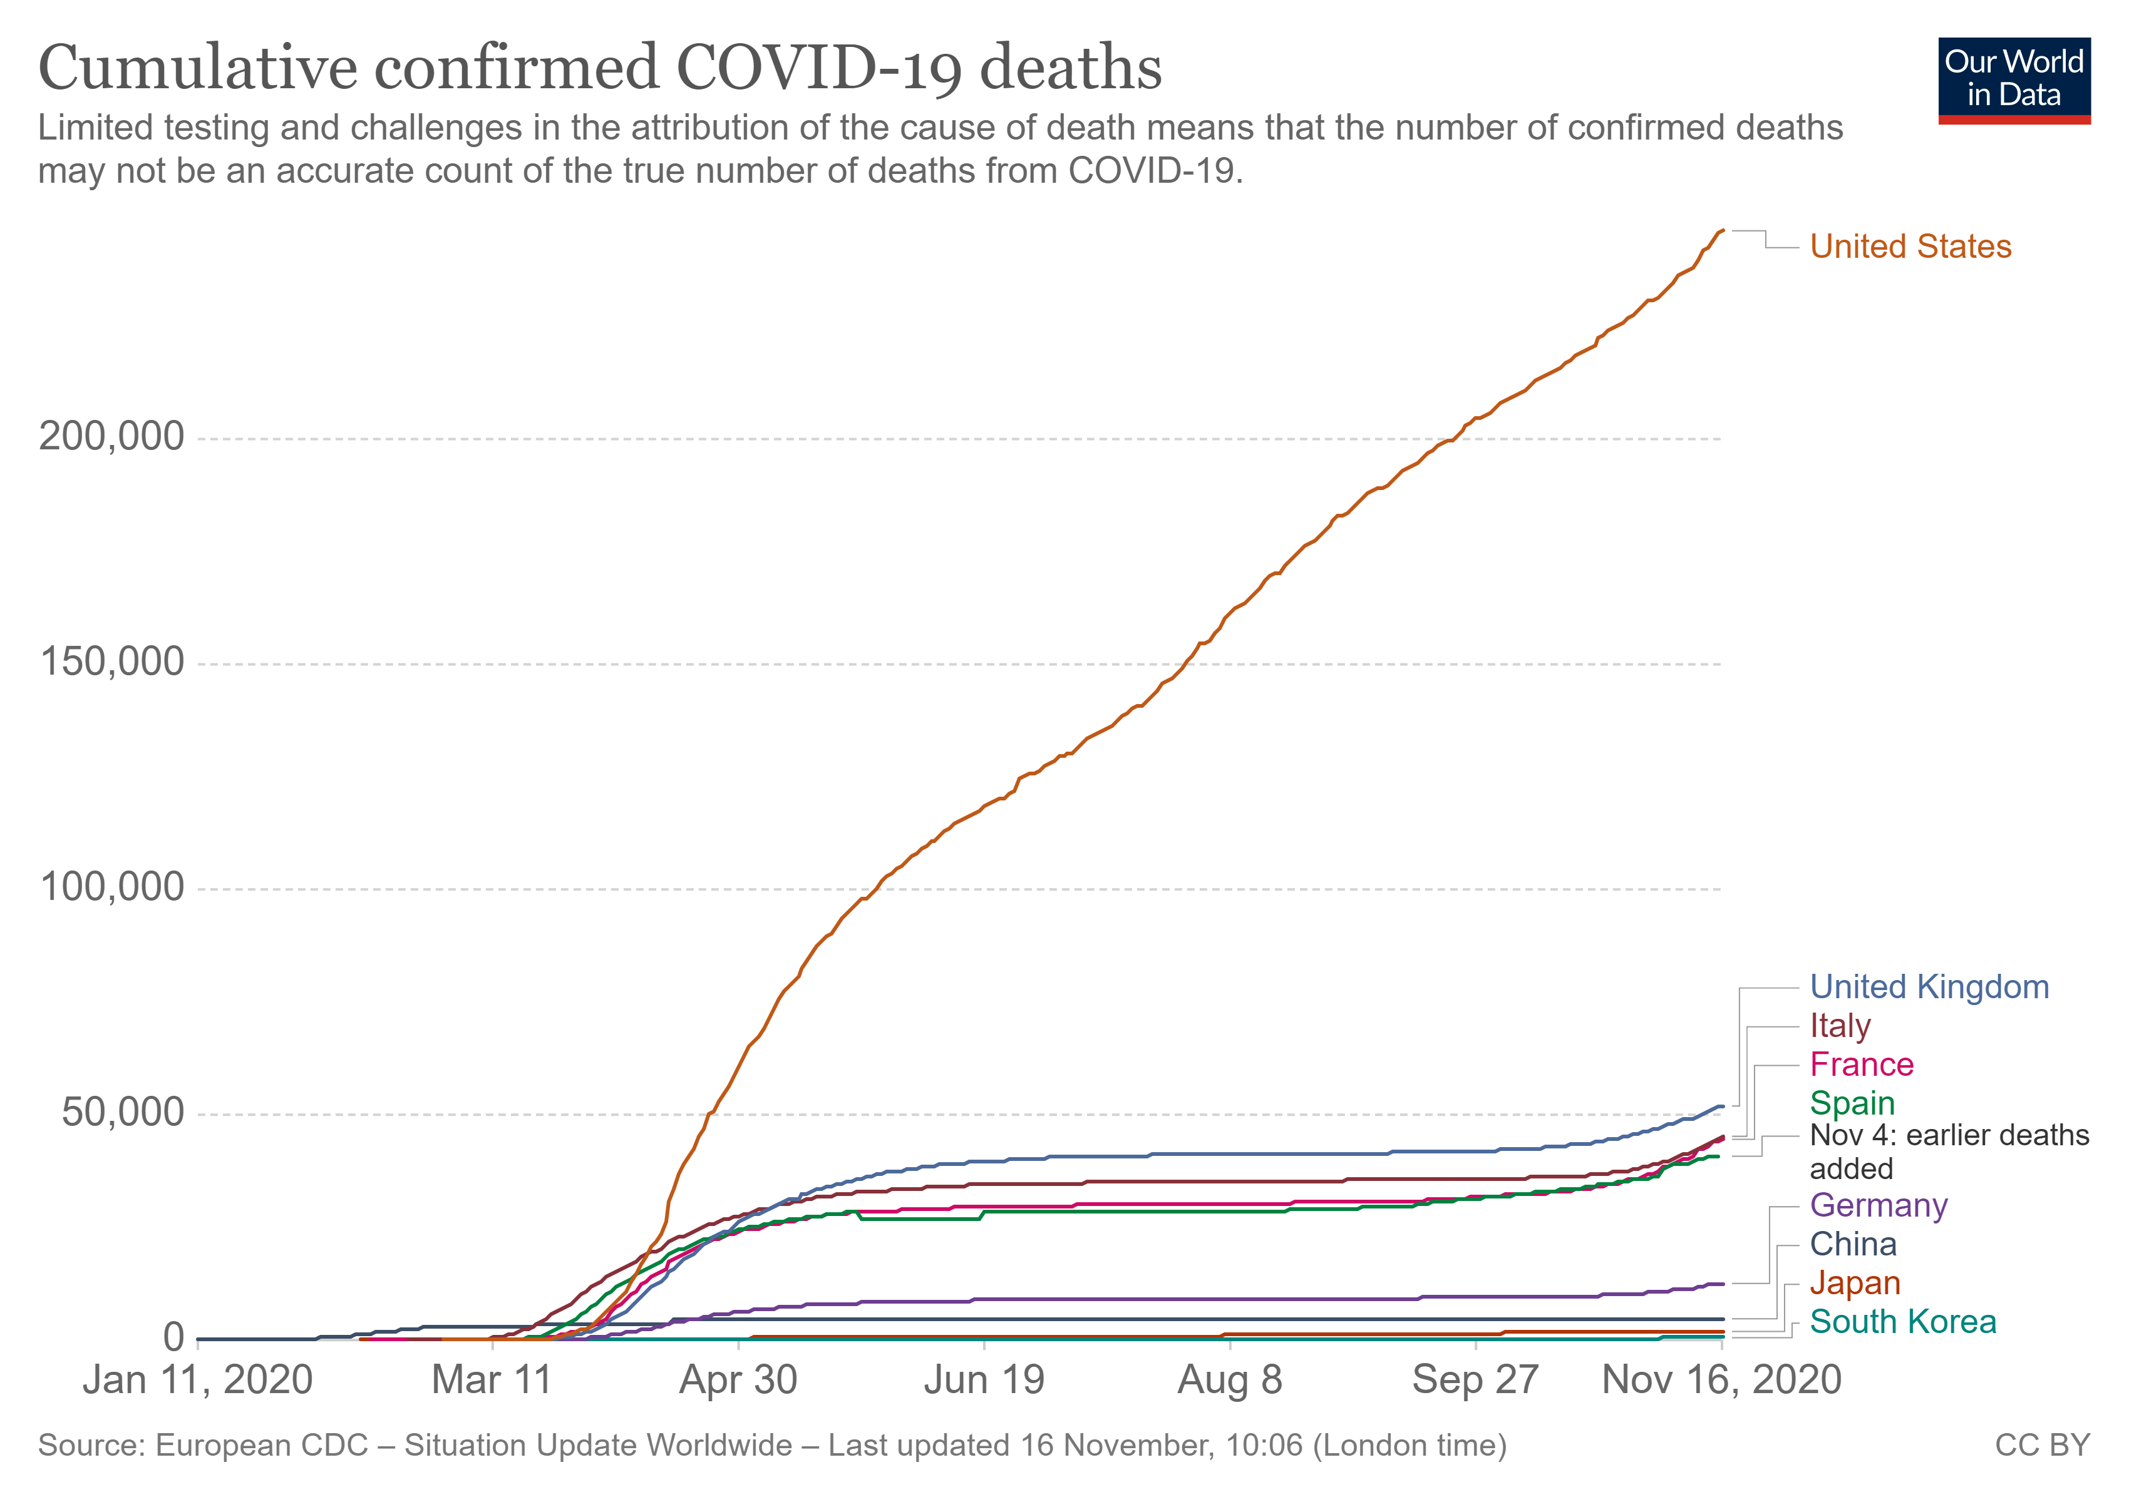
Area 2: Convergence of Multiple STEM Subjects
Our World in Data
“Coronavirus Pandemic (COVID-19),” by M. Roser, H. Ritchie, E. Ortiz-Ospina, and J. Hasell, 2020 https://ourworldindata.org/coronavirus
Notes:
Okhee

Slide 18
Area 2: Convergence of Multiple STEM Subjects
Area 2: Convergence of multiple STEM subjects facilitate K-12 students making informed decisions and taking responsible actions
In breakout rooms, explore the data (7 min)
Our World in Data
https://ourworldindata.org/coronavirus
Notes:
Okhee

Slide 19
Area 2: Convergence of Multiple STEM Subjects
Area 2: Convergence of multiple STEM subjects facilitate K-12 students making informed decisions and taking responsible actions
The New York Times
Coronavirus Map: Tracking the Global Outbreak
https://www.nytimes.com/interactive/2020/world/coronavirus-maps.html?campaign_id=9&emc=edit_NN_p_20200424&instance_id=17910&nl=morning-briefing&regi_id=128196943&section=topNews&segment_id=25875&te=1&user_id=8a1534b4d44c04ec54f11d47daf73a58
United States
States, Territories and Cities
Notes:
Okhee

Slide 20
Area 3: Social Justice for All
Area 3: STEM disciplines and STEM education in concert address systemic racism
1) Students attend to systemic racism in the COVID-19 pandemic
Notes:
Todd

Slide 21
Area 3: Social Justice for All
Area 3: STEM disciplines and STEM education in concert address systemic racism
Racial inequity of COVID-19
https://www.nytimes.com/interactive/2020/07/05/us/coronavirus-latinos-african-americans-cdc-data.html?action=click&campaign_id=9&emc=edit_nn_20200706&instance_id=20044&module=Top+Stories&nl=the-morning&pgtype=Homepage&regi_id=128196943&segment_id=32688&te=1&user_id=8a1534b4d44c04ec54f11d47daf73a58
Latinos with an especially high infection rate of COVID-19, a sign of a makeup of essential work force
https://www.nytimes.com/2020/06/26/us/corona-virus-latinos.html?campaign_id=9&emc=edit_nn_20200626&instance_id=19769&nl=the-morning&regi_id=128196943&segment_id=31917&te=1&user_id=8a1534b4d44c04ec54f11d47daf73a58
Notes:
Todd

Slide 22
Area 3: Social Justice for All
Area 3: STEM disciplines and STEM education in concert address systemic racism
2) Students understand that solutions to the COVID-19 pandemic involve addressing systemic racism
Black-White income gap
https://www.wsj.com/articles/for-african-americans-a-painful-economic-reversal-of-fortune-11591176602?st=6peib0558gnq91l
Black-White wage gap
https://www.nytimes.com/2020/06/25/briefing/coronavirus-ahmaud-arbery-hamilton-your-thursday-briefing.html
High incarceration rates of black men
https://www.nytimes.com/2020/06/03/briefing/protests-steve-king-coronavirus-your-wednesday-briefing.html
Notes:
Todd

Slide 23
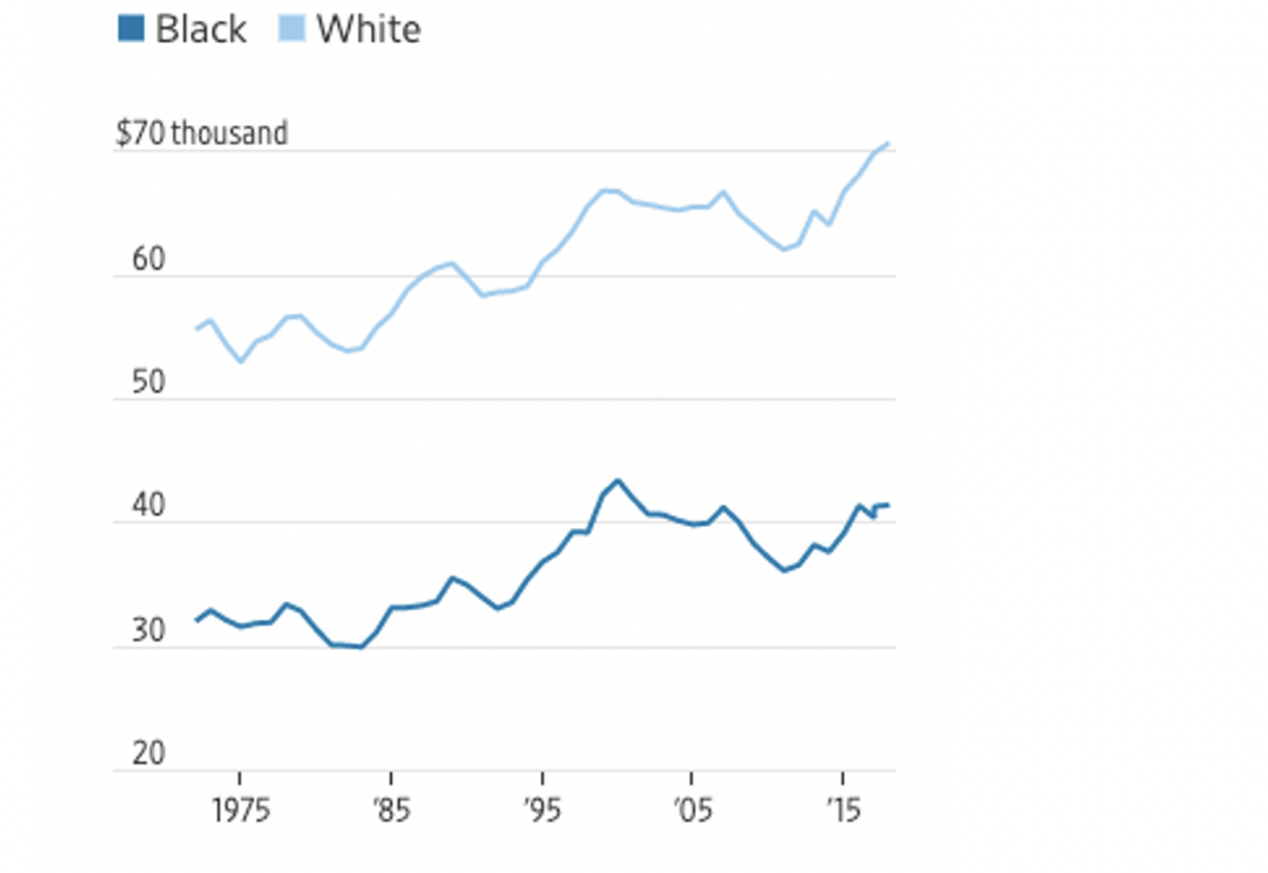
Area 3: Social Justice for All
Income Gap Between Black and White Households
The Wall Street Journal
“For African-Americans, a Painful Economic Reversal of Fortune,” by G. Ip, 2020
https://www.wsj.com/articles/for-african-americans-a-painful-economic-reversal-of-fortune-11591176602?st=6peib0558gnq91l
Notes:
Todd

Slide 24
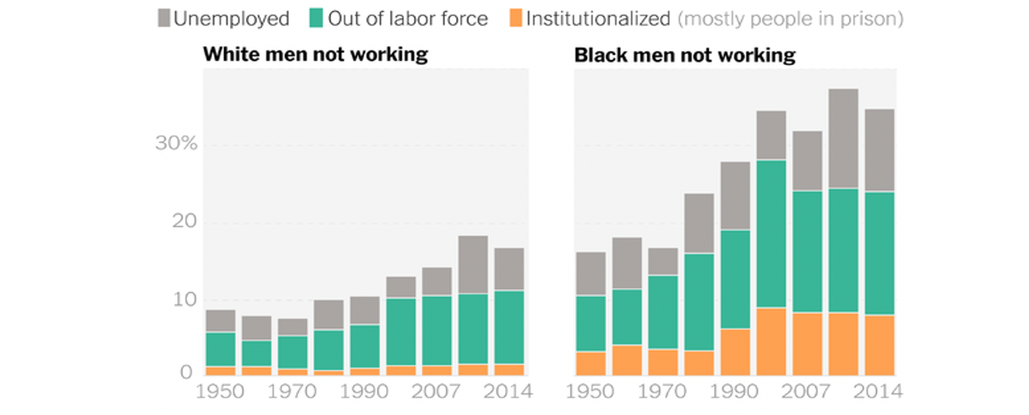
Area 3: Social Justice for All
Unemployment Gap Between Black and White Men
The New York Times
“The Enormous Black-White Wage Gap,” by D. Leonhardt, 2020
https://www.nytimes.com/2020/06/25/briefing/coronavirus-ahmaud-arbery-hamilton-your-thursday-briefing.html
Notes:
Todd

Slide 25
Area 3: Social Justice for All
COVID-19 provides an example of how students can attend to the consequences of systemic racism while participating in STEM education
Such systemic racism manifests in disproportionately higher rates of COVID-19 cases and deaths among racial minorities, low-income communities, inmates, and other marginalized groups
As students recognize systemic racism associated with COVID-19, they are positioned to question underlying reasons for its existence and propose potential justice-centered solutions to begin to address systemic racism in the society at large
Notes:
Todd

Slide 26
NSTA Daily Do Lesson
The following is an example of what our framework might look like in the context of a middle school science lesson:
How can we make informed decisions to keep ourselves and our communities safe during the COVID-19 pandemic?
Students and their families explain differences found when comparing COVID-19 data for their local county to COVID-19 data for another county (or equivalent) and propose informed solutions for keeping themselves and their communities safe.
Notes:
Todd

Slide 27
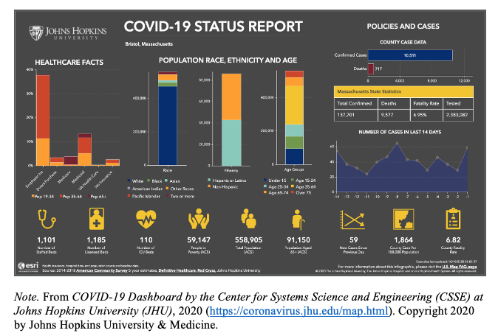
NSTA Daily Do Lesson
In the Lesson – Part 1
Students examine local and regional patterns of COVID19 spread and make observations using the Johns Hopkins Coronavirus Resource Center’s COVID-19 Dashboard
[Data Science]
Notes:
Todd

Slide 28
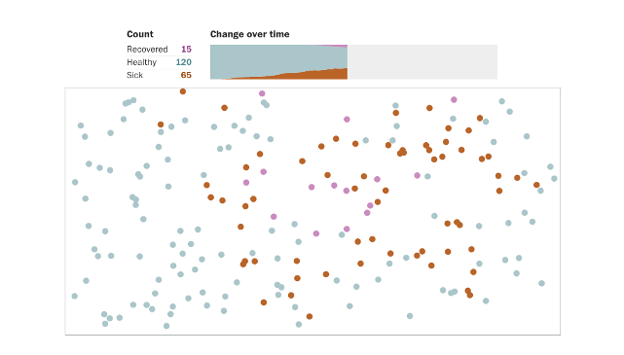
NSTA Daily Do Lesson
In the Lesson – Part 2
Students explore simulations to better understand the mechanism of viral spread and strategies for flattening the curve of viral spread amongst a population
[Simulations/Computer Science]
Notes:
Todd

Slide 29
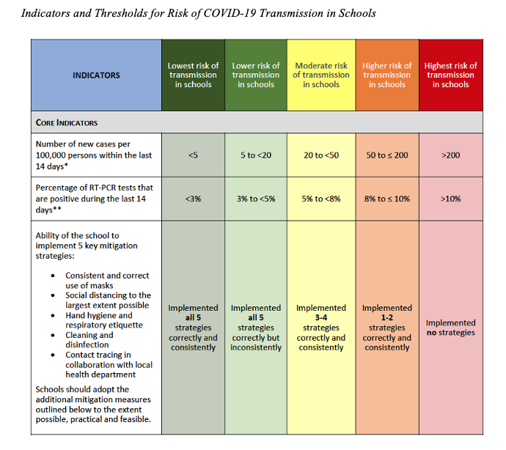
NSTA Daily Do Lesson
In the Lesson – Part 3
Students examine CDC guidance and propose recommendation for their schools
[Making informed decisions and taking responsible action]
Notes:
Todd

Slide 30
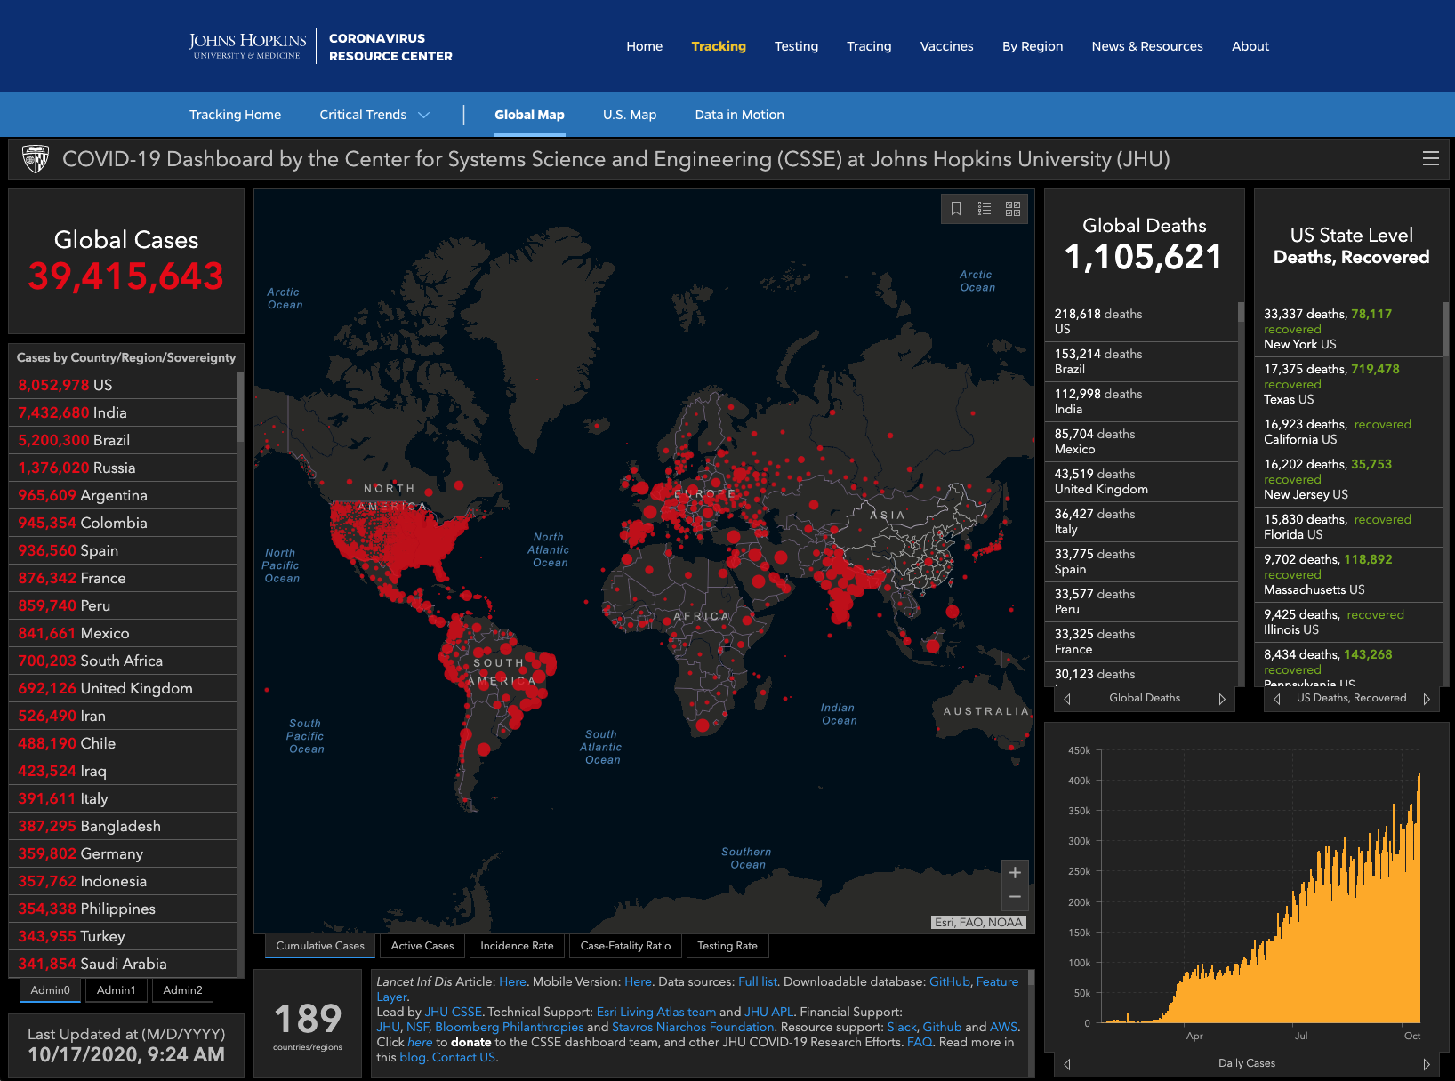
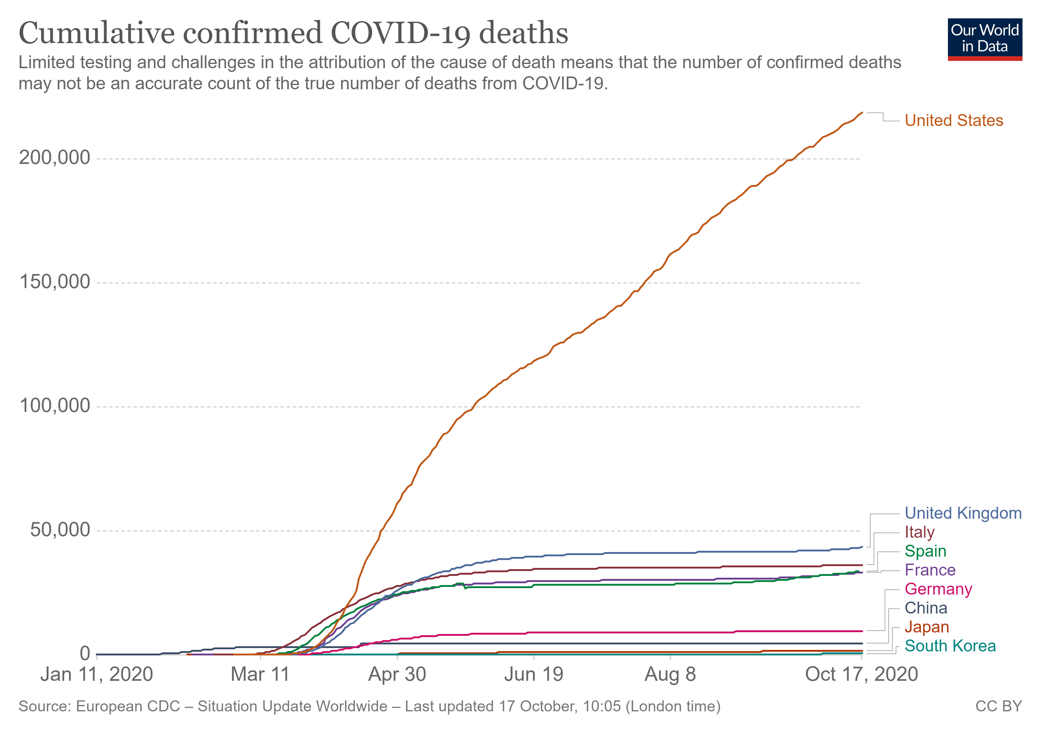
Summary
Use Multiple STEM Subjects to Make Sense of Complex Societal Phenomena and Problems
While Addressing Systemic Racism
Income Gap
Notes:
Okhee

Slide 31
New Roles for STEM Educators
Capitalize on the unparalleled opportunities as well as challenges presented by COVID-19
Envision a new–better–normal for STEM education centered around social justice for all students
Notes:
Okhee

Slide 32
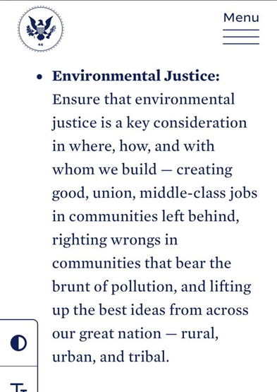
Notes:
Todd

Slide 33
Q&A
Please type your questions on Chat
(2 min)

Slide 34
Thank You
Okhee Lee, New York University
&
Todd Campbell, University of Connecticut

